Slide 1
脱机命令接口（批处理脚本）
@echo off
set rarpath="c:\program files\winrar\"
set logpath=c:\log\
set prefix=anc
rem 获取昨天日期
set YE=%date:~0,4%
set MO=%date:~5,2%
……
set Han=%LY%-%LM%-%LD%
echo 昨天的日期为：%Han%
%logpath:~0,2%
cd %logpath%
%rarpath%rar.exe a %prefix%_server_%Han%.rar server_%Han%.log

Slide 2
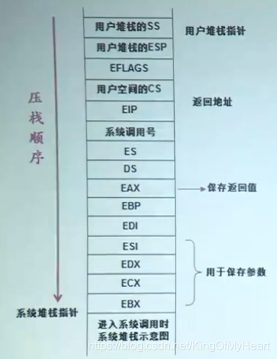
系统调用时的内核栈

Slide 3
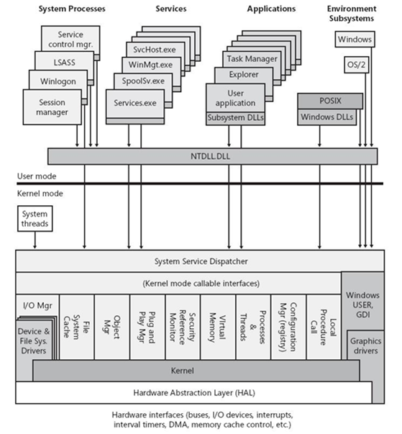
Windows架构

Slide 4
A Simplest Win32 Program
Important basic concepts
Message & message queue
A structure sent by OS, to inform the application about some events
Handle of window, indicating which window the message is sent to
Message ID, indicating what kind of message this is
wParam & lParam, two 32-bit parameters, different use for different message
Each UI thread has a message queue (maintained by OS), its program can get a message through the API function GetMessage()
A Windows application does not execute and quit immediately, the main task throughout its life is to process messages
In order to respond to the messages generated from time to time, an application must include a “message loop” in its program
Notes:
Message example: WM_LBUTTONDOWN, indicating the left button is pushed down.
wParam holds a series of bit flags identifying the state of the Ctrl and Shift keys and of the mouse buttons.
lParam holds two 16-bit values identifying the location of the mouse pointer when the click occurred

Slide 5
A Simplest Win32 Program
Important basic concepts
Callback function
A function written by the application programmer, whose pointer (address) is passed to OS by the programmer, and called by OS
Handle
Basically, an integer, an ID number identifying some system object
System object: something belonging to the OS, but may be operated by the applications, for example, a thread, a window, a menu, a button, a screen area, …
For security consideration, the OS cannot pass the pointer (address) of a system object to the applications, instead, it passes an ID
Taking a handle as parameter, an application can operate on a system object by calling APIs
Notes:
Why callback? Sometimes the OS knows the basic process of a task, but the specific task at a certain step may be up to the application, and the OS has no idea about that.
Example 1: message process
Example 2: system font enumeration

Slide 6
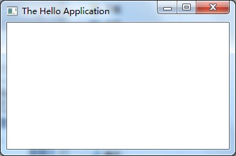
A Simplest Win32 Program
WinMain()
Register Window
Create Window
Show Window
Message Loop
WndProc(hwnd, …)
switch (message) {
…
case WM_PAINT:
Get client area
Paint something
…
}
Model
Simply a window frame, no content
Callback
Hi, Windows, I have a window like this …
The messages for my window should be processed by this guy (WndProc)
GetMessage
Application
Windows
Hi, Windows, I have finished the pre-processing of the message
msg queue

Slide 7
A Simplest Win32 Program
#include <windows.h>
LONG WINAPI WndProc (HWND, UINT, WPARAM, LPARAM);
int WINAPI WinMain (HINSTANCE hInstance, HINSTANCE hPrevInstance,
LPSTR lpszCmdLine, int nCmdShow)
{
WNDCLASS wc;
HWND hwnd;
MSG msg;
wc.style = 0; // Class style
wc.lpfnWndProc = (WNDPROC) WndProc; // Window procedure
wc.cbClsExtra = 0; // Class extra bytes
wc.cbWndExtra = 0; // Window extra bytes
wc.hInstance = hInstance; // Instance handle
wc.hIcon = LoadIcon (NULL, IDI_WINLOGO); // Icon handle
wc.hCursor = LoadCursor (NULL, IDC_ARROW); // Cursor handle
wc.hbrBackground = (HBRUSH) (COLOR_WINDOW + 1); // Background color
wc.lpszMenuName = NULL; // Menu name
wc.lpszClassName = "MyWndClass"; // WNDCLASS name
RegisterClass (&wc);
……
Set some styles for the window class

Slide 8
A Simplest Win32 Program
……
hwnd = CreateWindow (
"MyWndClass", // WNDCLASS name
"SDK Application", // Window title
WS_OVERLAPPEDWINDOW, // Window style
CW_USEDEFAULT, // Horizontal position
CW_USEDEFAULT, // Vertical position
CW_USEDEFAULT, // Initial width
CW_USEDEFAULT, // Initial height
HWND_DESKTOP, // Handle of parent window
NULL, // Menu handle
hInstance, // Application's instance handle
NULL // Window-creation data
);
ShowWindow (hwnd, nCmdShow);
UpdateWindow (hwnd);
while (GetMessage (&msg, NULL, 0, 0)) {
TranslateMessage (&msg);
DispatchMessage (&msg);
}
return msg.wParam;
}
Set some styles for the window

Slide 9
A Simplest Win32 Program
LRESULT CALLBACK WndProc (HWND hwnd, UINT message, WPARAM wParam,
LPARAM lParam)
{
PAINTSTRUCT ps;
HDC hdc;
switch (message) {
case WM_PAINT:
hdc = BeginPaint (hwnd, &ps);
Ellipse (hdc, 0, 0, 200, 100);
EndPaint (hwnd, &ps);
return 0;
case WM_DESTROY:
PostQuitMessage (0);
return 0;
}
return DefWindowProc (hwnd, message, wParam, lParam);
}

